Slide 1
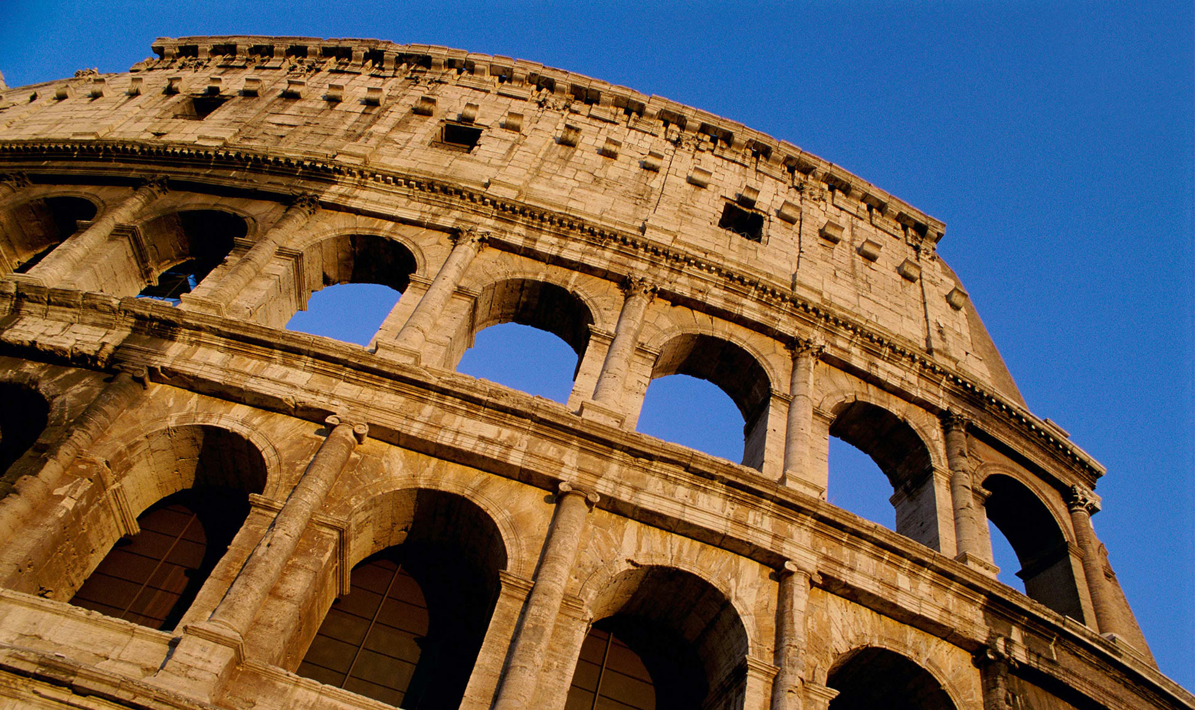
컴퓨팅사고와 SW코딩
안병준 coolbrise@knu.ac.kr

Slide 2
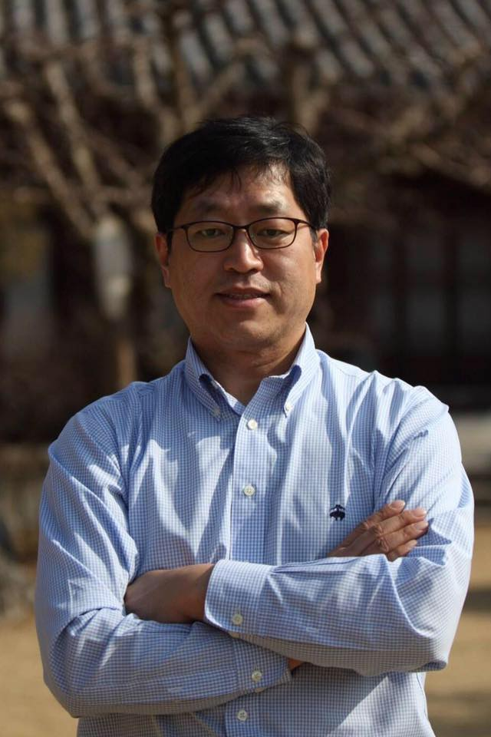
안 병 준
경북대학교 컴퓨터학부 겸임교수
coolbrise@knu.ac.kr
경북대학교 컴퓨터공학과 86학번
경북대학교 컴퓨터학부 동문회 부회장 / 사무국장
High Performance Computing Specialist
Microsoft Korea
Distinguished Toastmaster

Slide 3


Slide 4
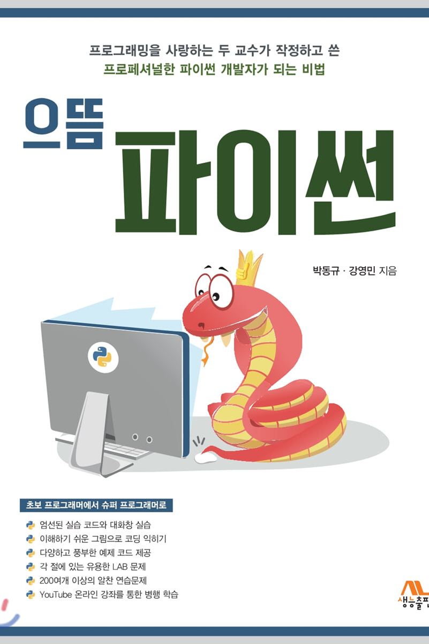
Main Textbook
http://www.yes24.com/Product/Goods/89140722
https://www.aladin.co.kr/shop/wproduct.aspx?ItemId=233461615
https://www.youtube.com/playlist?list=PL2P1Vm9k53HOflCAdyYaOx7hfBHydWNcL

Slide 5
Teaching
Supplementary textbooks
https://docs.python.org/3.10/
https://wikidocs.net/book/1
https://dojang.io/course/view.php?id=7
Ground rules
Be aggressive; Be curious; Be passionate; Be tenacious;
Zero Tolerance - equal or more than 4 times absences
Tutors

Slide 6
Final Grade
Mid-term exam : 30%
Final exam : 30%
Assignments : 20%
Submit your assignments by 23:59:59 next Wednesday
Attendance : 10%
No cheating
Attitude : 10%

Slide 7


Slide 8


Slide 9
Toastmasters
Mission Statement
We provide a supportive and positive learning environment in which members are empowered to develop communication and leadership skills, resulting in greater self-confidence and personal growth.
Daegu Toastmasters
Saturday morning
Y.O.L.O. Toastmasters
Tuesday evening
Submit the pictures via e-mail after attending a meeting. You’ll get an extra point at Attitude criteria.

Slide 10
Exams
Mid-term exam date: Oct. 27
Final exam date: Dec. 15

Slide 11


Slide 12
Ice Breaking
Make a group of two people
A person talks to the other for 3 minutes.
The other listens to him or her without saying anything.
Change the roles after 3 minutes.
Theme : What did you do in the summer vacation?
Presenter : Sharing what you heard and learned.

Slide 13

Who are you?

Slide 14


Slide 15


Slide 16
5 things in common.
Make a group of four people.
Set your group name.
Appoint the representative of your group.
You have 10 minutes to find out 5 things in common.
Each group’s representative will have 2 to 3 minutes to present 5 things in common at the podium.
Which group do you think the best?

Slide 17


Slide 18
Assignment #1
Go to the library and borrow a Python book; And then send the picture of it to me via email.
Install any Python development tool on your laptop or desktop or other PC; And then send the picture of it to me and the name of the Python development tool via email.
Choose and solve at least 5 questions from Chap. 1 Exercise; Submit the result via email.

Slide 19
Prepare for the 2nd week
What is Git & GitHub?
Google Search
https://support.google.com/websearch/answer/134479?hl=en

Slide 20
Further Studies
The Missing Semester of Your CS Education
https://missing.csail.mit.edu/
Subscribe to a Python newsletter.
https://pycoders.com/
Watch a movie
https://www.imdb.com/title/tt2084970

Slide 21
“I have this hope that there is a better way. Higher-level tools that actually let you see the structure of the software more clearly will be of tremendous value.”
– Guido Van Rossum

